Slide 1
ST0502 Fundamentals of Programming
Topic 2 Operators & Selections (I)
Official (Open) Non sensitive

Slide 2
Operations & Selections
To identify a constant variable
To identify the various operators for the different data types
To execute a program using the readline-sync library
To convert variable to different data types using existing function
To differentiate the different types of errors - syntax, runtime, and logic errors.
To implement selection control using one-way if statements.
Official (Open) Non sensitive

Slide 3

Recap last session……………

Slide 4
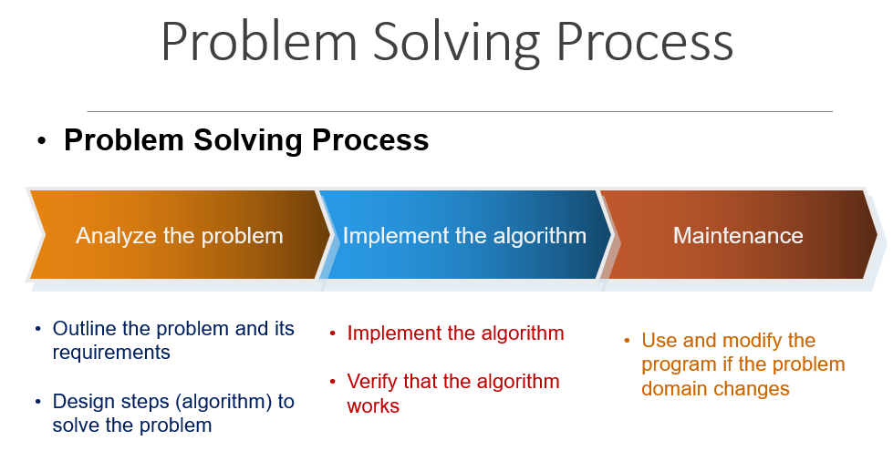
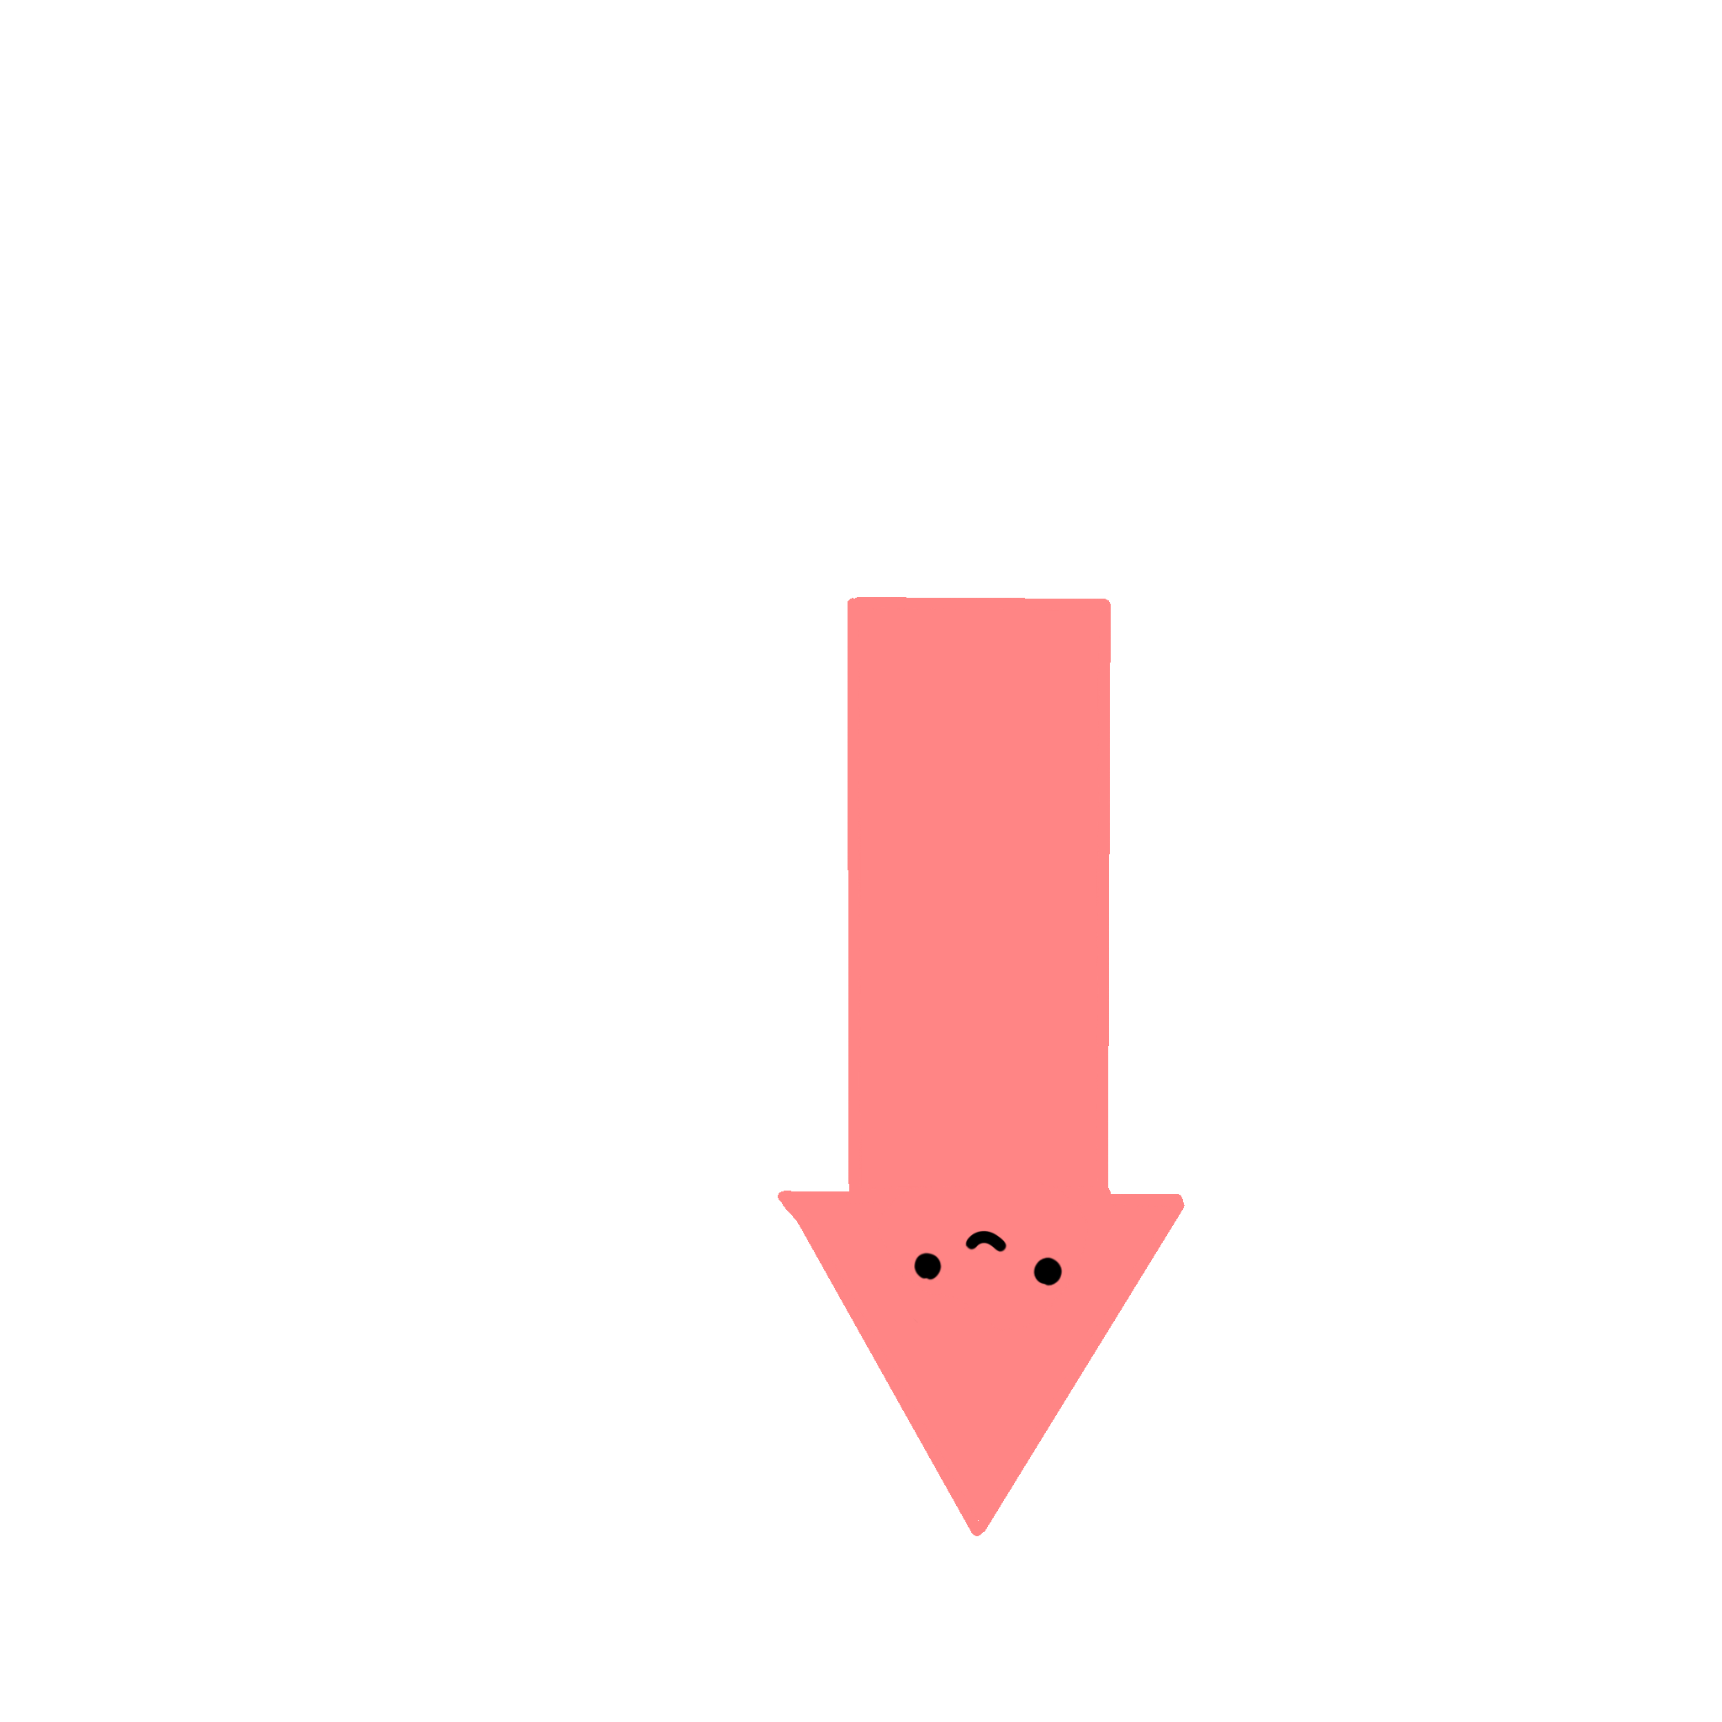

Slide 5
Recap
Extra
A statement represent(s) an action or a sequence of actions.
On good programming practice, a group of statements normally know as a block carries out a specific task is normally grouped by :
Indentation
Blank lines before and after
{}

Slide 6
Recap
Extra
console.log()
Escape codes
Variables
Naming Conventions
Declaration
Initialisation
Data types

Slide 7
Constants
Modified
Represents permanent data that never changes
(eg ∏ or pi = 3.14159)
2 benefits:
The const keyword ensures that the value cannot be altered/changed.
Makes program readable, generally denoted in uppercase letters
Syntax:
E.g: const PI = 3.14159;
const variableName = value;

Slide 8
Class Exercise:
What is wrong with the program?
Try now and see what error message you will get.
const a = 3.1;
a = 6;
DEMO TIME
const ➔ Cannot change value

Slide 9
Numeric Operators
Modified
+, -, *, /, %
Operator | Meaning | Example | Result
+ | Addition | 34 + 1 | 35
- | Subtraction | 34.0 – 0.1 | 33.9
* | Multiplication | 300 * 30 | 9000
/ | Division | 1.0 / 2.0 | 0.5
% | Remainder (Modulus) | 20 % 3 | 2
** | Exponentiation | 4 ** 3 | 64
Can work with floating points
Can work with floating points
var a = 34;
var b = 1;
var c = a +b;
Coding examples:
var a = 34;
var c = a + 1; 1;
or:
or:
var c = 34 + 1;

Slide 10
Numeric Operators
Operator | Meaning | Exercises | Result
+ | Addition | 46+6
- | Subtraction | 20.0 – 0.4
* | Multiplication | (a) 2 * 5 (b)1.5 * 3
/ | Division | (a) 5 / 2 (b) 5.0/2.0
% | Remainder (Modulus) | (a) 5 % 2 (b) 15%5 (c) 1%6
** | Exponentiation | (a) 4**2 (b) 3.0 ** 3

Slide 11
Numeric Operators (Answers)
Modified
Operator | Meaning | Exercises | Result
+ | Addition | 46+6 | 52
- | Subtraction | 20.0 – 0.4 | 19.6
* | Multiplication | (a) 2 * 5 (b)1.5 * 3 | (a) 10 (b) 4.5
/ | Division | (a) 5 / 2 (b) 5.0/2.0 | (a) 2.5 (b) 2.5
% | Remainder (Modulus) | (a) 5 % 2 (b) 15%5 (c) 1%6 | (a) 1 (b) 0 (c) 1
** | Exponentiation | (a) 4**2 (b) 3.0 ** 3 | (a) 16 (b)27

Slide 12
Numeric Operator Precedence
Extra
Operator
()
**
* / %
+ -
In an expression,
portions with operators of equal precedence is evaluated from left to right

Slide 13
Use of Remainder (Modulus) Operator %
Modified
>To determine whether a number is even or odd:
An even number % 2 is always 0 i.e. no reminder
An odd number % 2 is always 1 i.e. reminder is 1
> To determine if a number is divisible by 5:
e.g Result of 67 % 5 is 2, but 65%5 is 0.
So if a number % 5 is always 0 ➔ that number is divisible by 5

Slide 14
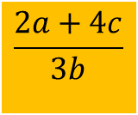
Exercise: Evaluating Expressions
Extra
$$\frac{2a+4c}{3b}$$
is translated to ?

Slide 15
Exercise: Evaluating Expressions
is translated to ?
(3 + 4 * x) / 5 – 10 * (y - 5) * (a+b+c) / x + 9 * (4 / x + (9+x) / y)

Slide 16
Shorthand Operators
Operator Example Equivalent
+= i+=8 i = i+8
-= f-=8.0 f = f-8.0
*= i*=8 i = i*8
/= i/=8 i = i/8
%= i%=8 i = i%8
**= i**=8 i = i**8
var a = 10;
Example:
var a = 10;
a -= 3;
➔
a = a - 3;
➔
a = 10 - 3;
➔
a = 7;

Slide 17
Application of Shorthand Operator += on Integer variable
Extra
var totalMarks=0;
totalMarks+=80;
totalMarks+=50
console.log(totalMarks);
Output:
130

Slide 18
Application of Shorthand Operator += on String variable
Extra
var s=“”;
s+=“AB”;
s+=“def”;
console.log(s);
Output:
ABdef

Slide 19
Increment and Decrement Operators
Operator Name Description
++var preincrement The expression (++var) increments var by 1 and evaluates to the new value in var after the increment.
var ++ postincrement The expression (var++) evaluates to the original value
in var and increments var by 1.
--var predecrement The expression (--var) decrements var by 1 and evaluates to the new value in var after the decrement.
var-- postdecrement The expression (var--) evaluates to the
original value in var and decrements var by 1.
If ++k or --k occurs in an expression, k is incremented or decremented by 1 before its new value is used in the expression.
If k++ or k-- occurs in an expression, k is incremented or decremented after its original value is used in the expression.

Slide 20
Increment and Decrement Operators
Modified
Operator Name Description
++var preincrement The expression (++var) increments var by 1 and evaluates to the new value in var after the increment.
--var predecrement The expression (--var) decrements var by 1 and evaluates to the new value in var after the decrement.
If ++k or --k occurs in an expression, k is incremented or decremented by 1 before its new value is used in the expression.
z=10;
console.log("z is " + ++z);
console.log("z is " + --z);
expression

Slide 21
Increment and Decrement Operators
Modified
If k++ or k-- occurs in an expression, k is incremented or decremented after its original value is used in the expression.
Operator Name Description
var ++ postincrement The expression (var++) evaluates to the original value
in var and increments var by 1.
var-- postdecrement The expression (var--) evaluates to the
original value in var and decrements var by 1.
z=1;
console.log("z is " + z++);
console.log("z is " + z--);
DEMO TIME
expression

Slide 22
Operator Precedence
Modified
Highest order
var++, var--
++var, --var
! (Not)
** (Exponentiation)
*, /, % (Multiplication, Division and Modulus)
+, - (Binary addition and subtraction)
<, <=, >, >= (Comparison)
==, !=; (Equality)
&& (Conditional AND)
|| (Conditional OR)
=, +=, -=, *=, /=, %= (Assignment operator)
IMPORTANT
Lowestorder

Slide 23
Example
Modified
i=10;
Equivalent to
newNum = 10*i;
newNum = 10*
i++
;
i = i + 1;
i=10;
Equivalent to
i = i + 1;
newNum = 10 *
(
++i)
;
newNum = 10*i;
Brackets are optional

Slide 24
Example
Modified
To solve a=++b + c++. Let’s work through it, given :
a = 1; b = 2; c = 3;
a = ++b + c++;
console.log(a); //6 is printed
console.log(b); //3 is printed
console.log(c); //4 is printed
b is incremented first (b = 3)
Original value of c is used
Then new value of b is used
a = 3
+ 3;
Then c is incremented. (c = 4)

Slide 25
Increment and Decrement Operators
Using increment and decrement operators makes expressions short, but it also makes them complex and difficult to read.
Avoid using these operators in expressions that modify multiple variables, or the same variable for multiple times such as this: k = ++i + i

Slide 26
DEMO TIME (2 demos)
Comparison Operators
Operator | Name | Example | Boolean result
< | Less than | 1 < 2 | true
<= | Less than or equal to | 1 <= 2 | true
> | Greater than | 1 > 2 | false
>= | Greater than or equal to | 1 >= 2 | false
== | Equal to | 1 == 2 | false
!= | Not equal to | 1 != 2 | true

Slide 27
Boolean Operators
Operator Name
! not
&& and
|| or

Slide 28
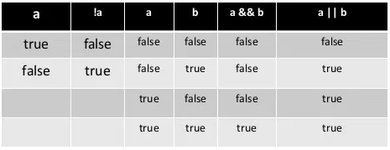
DEMO TIME
Boolean Operators
Truth table definitions of the boolean operators: AND (&&),OR (||), and NOT (!).
Boolean data have only two possible values, true and false.
a && b is true only if both a and b are true.
a || b is true if either a or b is true.
!a is true when a is false.

Slide 29
Example
Let’s work out the following text & translate to JS:
How to check if 8 can be divided by 2?
Solution: ??
Next how to check if 8 can also be divided by 3?
Solution: ??
Next, can 8 be divided by BOTH 2 & 3?
Next, can 8 be divided by EITHER 2 OR 3?

Slide 30
Modified
Possible Solutions?
var num = 8;
console.log("Is " + num + " divisible by 2 and 3? " +
((num % 2 == 0) && (num % 3 == 0)));
console.log("Is " + num + " divisible by 2 or 3? " +
((num % 2 == 0) || (num % 3 == 0)));
num%2 && num%3 gives true && false gives false
num%2 || num%3 gives true || false gives true

Slide 31
Operator Precedence
Highest order
var++, var--
++var, --var
! (Not)
** (Exponentiation)
*, /, % (Multiplication, Division and Modulus)
+, - (Binary addition and subtraction)
<, <=, >, >= (Comparison)
==, !=; (Equality)
&& (Conditional AND)
|| (Conditional OR)
=, +=, -=, *=, /=, %= (Assignment operator)
IMPORTANT
Lowestorder

Slide 32
Operator Precedence and Evaluation Order
The expression in the parentheses is evaluated first.
When evaluating an expression without parentheses, the operators are applied according to the precedence rule.
When 2 operators have the same precedence, the operands are then evaluated from left to right (of the expression).
a – b + c – d is equivalent to ((a – b) + c) – d
3%2*4 is equivalent to (3%2) * 4 , it is NOT equivalent to 3%(2*4)
2**3**2 is equivalent to 512, NOT 64

Slide 33
Operator Precedence and Evaluation Order
The expression 3 + 4 * 4 > 5 * (4 + 3) - 1 is evaluated as follows:
3 + 4 * 4 > 5 * (4 + 3)
-
1
(1) inside parentheses first
3 + 4 * 4 > 5 * 7
–
1
(2) multiplication
3 + 16 > 5 * 7
–
1
(3) multiplication
3 + 16 > 35
–
1
(4) addition
19 > 35
–
1
(5) subtraction
19 > 34
(6) greater than
false

Slide 34
Exercise: Operator Precedence
Extra
var i=10,j=11,k=30;
console.log(i<=10 || j<=11 && k<30)

Slide 35
String Data - Type
Modified
To represent a string of characters, use the data type called String.
Any value that is enclosed with either double quotation marks (" ") or single quotation marks (‘) or backticks (`) is treated as a String.
Declaring and assigning Strings
var message = "Hello class!"; message = 'Bye class!';

Slide 36
String Concatenation
// Three strings are concatenated
var message = "Welcome " + "to " + "FOP! ";
// String Chapter is concatenated with number 2
var s = "Chapter" + 2;
// String hi is concatenated with Boolean, true
var s1 = 'hi ' + !false;
message = “Welcome to FOP!”
s = “Chapter2”
s1 = “hi true”

Slide 37
Obtaining Input
Modified
Any information or data that is sent to a computer for processing is considered input. There are many types of input in programming such as keyboard input, or data from external files/database, data from barcode reader, data from RFID, etc.
For now, we will only be focusing on how to obtain keyboard input (capture/process what is keyed into our program) from the user.
To allow our JavaScript program to read user’s keyboard input, you will need to install an additional module, called readline-sync using NPM.
Nodes Package Manager – utilize 3rd party programs

Slide 38
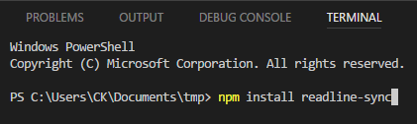
Obtaining Input
Modified
To install this module, we need to run the following command in the integrated terminal:
npm install readline-sync
Program that we want

Slide 39
What happened?
Extra
Extra
c:\FoP\node_modules\readline-sync\readline-sync.js
c:\FoP\node_modules\.package-lock
c:\FoP\node_modules\readline-sync\package.json
Downloaded from the web when npm install
External modules that your program needs
package.json
"homepage": "https://github.com/anseki/readline-sync",
"repository": {
"type": "git",
:

Slide 40
What happened?
Extra
Extra
Program that we want
c:\FoP\node_modules\readline-sync\readline-sync.js
c:\FoP\node_modules\.package-lock
c:\FoP\node_modules\readline-sync\package.json
Downloaded from the web when npm install
External modules that your program needs
package.json
"homepage": "https://github.com/anseki/readline-sync",
"repository": {
"type": "git",
:
Tracks program version installed
Track packages we use

Slide 41
Git & GitHub
Extra
Extra
1991 Finnish student Linus Torvalds created a new free operating system at age 22
Linux is a combination of UNIX and his name
Open source code
2005 Git VSC (version software control)
Open source development tool
2008 GitHub
Uses Git
Web based open source library
Collaborative work
Bragging rights

Slide 42
Getting User’s Keyboard Input
1. Create a readline-sync object
var input = require('readline-sync');
2. Use the methods question() to obtain user’s input in a form of a String
Declares that input is an object needed to capture keyboard input

Slide 43
Getting User’s Keyboard Input
Modified
Takes input data as string
var input = require('readline-sync');
var userName = input.question('May I have your name? ');
console.log('Hi ' + userName + '!');
var favFood = input.question('What is your favourite food? ');
console.log('Oh, ' + userName + ' loves ' + favFood + '!');
Program is paused here for user’s input
Takes input data as string
May I have your name? C.K.
Hi C.K!
What is your favourite Food? Satay
Oh, C.K. loves Satay!
User’s Keyboard Input

Slide 44
Converting Strings to Numbers
Modified
The input returned from the keyboard is a string.
To obtain the input as a number, you have to convert a string into a number.
To convert a string into an integer (whole number), you can use the built-in parseInt function as follows:
var intValue = parseInt ( intString );
where intString is a numeric string such as “123”.
Similarly, To convert a string into an float, you can use the built-in parseFloat function.
Convert string to int
Convert string to floating point

Slide 45
Example
Parsing String values into numerical format
var adminNum = parseInt("123456");
var salary = parseFloat("1234.5");

Slide 46
Example
var input = require('readline-sync');
var salary, userInput;
userInput = input.question("Please enter your salary: ");
Sample output:
User enters 1234.50 and press enter
This is a string value but we need a floating point number !!
userInput = “1234.50”

Slide 47
Example
modified
var input = require('readline-sync');
var salary, userInput;
userInput = input.question("Please enter your salary: "); salary = parseFloat(userInput);
Converts a string value into a floating-point number
Therefore, assuming user enters 1234.50, userInput contains data “1234.50” salary contains data 1234.5

Slide 48
Example (cont’d)
Extra
What is data is stored in age1 and age2?
var age1, age2;
age1 = parseInt(“123.4”);
age2 = parseInt(“123.8”);
age1
123
age2
123
Let’s try on Visual Studio now!!

Slide 49
Capturing numeric value directly
Use .questionInt() or .questionFloat() instead of .question() when reading input.
This will convert to numeric and if a non-numeric is entered, it will reprompt.

Slide 50
Example (cont’d)
Extra
var input = require('readline-sync');
var salary, userInput;
userInput = input.question("Please enter your salary: ");
salary = parseFloat(userInput);
previous codes
var input = require('readline-sync');
var salary;
salary = input.questionFloat("Please enter your salary: ");
rewritten
codes

Slide 51
Note
Extra
Note:
questionInt() only accepts integer input
questionFloat() only accepts floating point number input
Any input violates the requested data type will display an error message and re-prompting for input again until the input fulfils the correct data type.

Slide 52
Exercises:
Assuming you have a variable year as an integer value :
Write JS code using a % operator to check if year is divisible by 4.
Write JS code using a % operator to check if year is not by divisible by 100.
Write JS code using a % operator again to check if year is divisible by 400.

Slide 53
Exercises:
Assuming you have a variable year as an integer value:
a) Write JS code using a % operator to check if year is divisible by 4.
Ans : (year % 4 == 0) must be true
b) Write JS code using a % operator to check if year is not by divisible by 100
Ans : (year % 100 != 0) must be true
c) Write JS code using a % operator again to check if year is divisible by 400.
Ans : (year % 400 == 0) must be true

Slide 54
Example: Let’s combine them to test for leap Year
Assuming a program first prompts the user to enter a year as an integer value and checks if it is a leap year.
Given a year is a leap year if it is divisible by 4 but not by 100, or it is divisible by 400.
((year % 4 == 0) && (year % 100 != 0)) || (year % 400 == 0))

Slide 55
Example: Leap Year
var input = require('readline-sync');
var userInput, intYear, isLeapYear;
//prompt the user to enter a year
userInput = input.question("Enter a year: ");
//Convert the string entered into an integer value
intYear = parseInt(userInput)
//Check if the year is a leap year
isLeapYear = ((intYear % 4 == 0) && (intYear % 100 != 0)) ||
(intYear % 400 == 0);
//Display the result
console.log(intYear + " is a leap year? " + isLeapYear);

Slide 56
Converting Strings to Numbers
However, in some circumstances these conversions might not be necessary in JavaScript.
JavaScript is capable of doing certain calculations with string i.e. multiplication, subtraction and division.
The result of the calculation is of type “number”.
Unfortunately, this auto-conversion does NOT work with ‘addition’. The + symbol serves 2 purposes i.e. concatenation and addition. Whenever one of the operands is a string, the result of the operation will be a string too.
Therefore, it is advisable to always use conversion function whenever you accept the keyboard input.

Slide 57
Converting Strings to Numbers
var input = require('readline-sync');
x = "5";
num1 = x * 2; //10
num2 = x / 2; //2.5
num3 = x - 2; //3
num4 = x + 2; //"52"
console.log(typeof num1); //number
console.log(typeof num2); //number
console.log(typeof num3); //number
console.log(typeof num4); //string
Error ?

Slide 58
Programming Errors
Syntax Errors
Detected by the compiler
Runtime Errors
Causes the program to abort
Logic Errors
Produces incorrect result
Syntax Errors
var x = 20;
var y = x * 2;
Console.log(x + y);

Slide 59
Programming Errors
Syntax Errors
Detected by the compiler
Runtime Errors
Causes the program to abort
Logic Errors
Produces incorrect result
Runtime Errors
var i = 10/0;
Notes:
E.G. Missing files

Slide 60
Programming Errors
Syntax Errors
Detected by the compiler
Runtime Errors
Causes the program to abort
Logic Errors
Produces incorrect result
// Add num1 to num2
var num1 = 3,
var num2 = 2;
num2 += num1 + num2;
console.log("Answer" + num2);
Logic Errors

Slide 61
Selection Statement (I)
What if …

Slide 62
Selection Statements
Most of the time when we write code, we would want the code to perform different actions for different decisions.
We can use selection statements in our code to do this.
{… } is used to form a block that groups components of a program
Syntax:
Case sensitive
Parenthesis enclosing condition
No semi-colon here
Curly brackets enclosing if statement(s)
=if block executed when condition is true
if ( condition ) {
// code to be executed if the condition is true
}

Slide 63
Example
Since mark is more than 80, the condition is true, so “Your grade is A” will be displayed in the output.
var mark = 90;
if ( mark >= 80 ) {
grade = ‘A’;
}
console.log( ‘Your grade is ’ + grade );

Slide 64
Example
Now, mark is less than 80 resulting the condition is false, hence does not execute line grade=‘A’;
There is no output displayed but resulted in ReferenceError: grade is not defined.
var mark = 79;
if ( mark >= 80 ) {
grade = ‘A’;
}
console.log( ‘Your grade is ’ + grade );

Slide 65
Take note!
Adding a semicolon at the end of an if clause is a common mistake.
This mistake is hard to find, because it is not a compilation error or a runtime error, it is a logic error.
This error often occurs when you use the next-line block style.
WRONG !!
if ( mark >= 80 ); {
grade = ‘A’;
}
console.log( ‘Your grade is ’ + grade );

Slide 66

What have we learnt?
To identify a constant variable
To identify the various operators for the different data types
To execute a program using the readline-sync library
To differentiate the different types of errors - syntax, runtime, and logic errors.
To implement selection control using one-way if statements.
Great job everyone !!

Slide 67
ST0502 Fundamentals of Programming
Topic 2 Operators & Selections (I)
Official (Open) Non sensitive

Slide 68


Slide 69
Demo
Extra
var salary=4000,increment=500;
console.log(34+1);
console.log("New salary: “ + salary);
console.log("New salary: ” + (salary + 500));
expression
expression
expression

